Slide 1

Representation Powers
and
Mandates
RPaM
DIGIT
2nd Working Group Meeting
31st January 2019

Slide 2

Agenda
RPaM Working Group Meeting #2
Content
Round Table
Meeting objectives
Recap
Ongoing activities
Requests to the WG members
Next WG sessions
Questions and suggestions (WG members)

Slide 3
1
Round
Table

Slide 4


1
Round Table
DIGIT and MS
everis team
European Commission
Miguel Álvarez-Rodríguez (DIGIT, project owner)
Frédéric Poels (DIGIT, project owner)
Carlos Gómez-Muñoz (DG CNNECT, project owner)
Valentin Mesaros (DIGIT, analyst)
Member States and Stakeholders:
everis
Virginia Gomáriz (client manager)
Rui Venâncio (project manager)
Enric Staromiejski (eGovernment and interoperability)
Laia Bota (semantics analyst)
Danae Djin Ah Armelle Desplanques (business analyst)
Jade Maana (developer)

Slide 5
2
Meeting objectives

Slide 6
2
Meeting objectives
Recap on the previous WG-Meeting
Reminder on the overall objective
On-going activities
Progress made
Specific requests to the WG members
Road-map and prioritizing tasks

Slide 7
3
Recap

Slide 8
3
Recap of the previous WG meeting
Tools for collaboration:
GitHub:
Landing page
Issues
eMail: rpam-wg@everis.com
Glossary:
Use of the Issues for the improvement of the thesaurus
Maintenance by the RPaM development team (Excel)
Use Cases and Scenarios:
Documentation online
RPaM Ontology (Data Model):
Access to the descriptive page and the EAP file
Use of the issues for the improvement of the Conceptual Data Model and unitary tests
Main objective of this project (reminder):
To come up with a common RPaM Domain Ontology and sets of business rules
Identify solutions for the federation and interoperability of Mandates

Slide 9
4
Ongoing
activities

Slide 10
4
Ongoing activities
New branch 1.1.0 created in GitHub
Mapping the MS information Requirements to the RPaM Ontology
RPaM Ontology evolution
Mandate
Request
Service Provider Information Requirements and Constraints
Needs and rules:
Identifying business domain and technical needs and rules

Slide 11
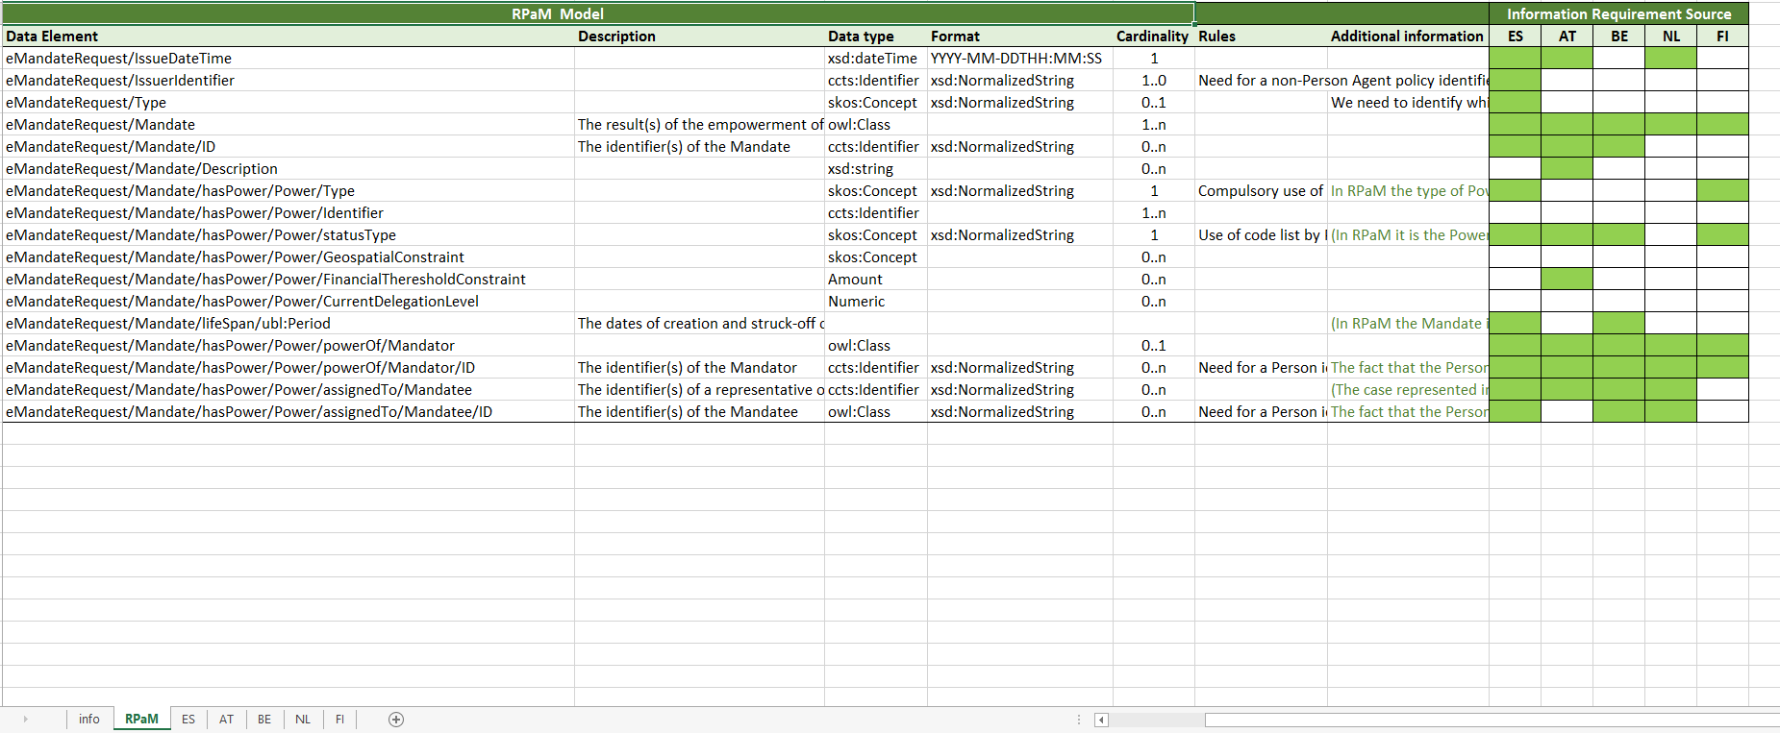
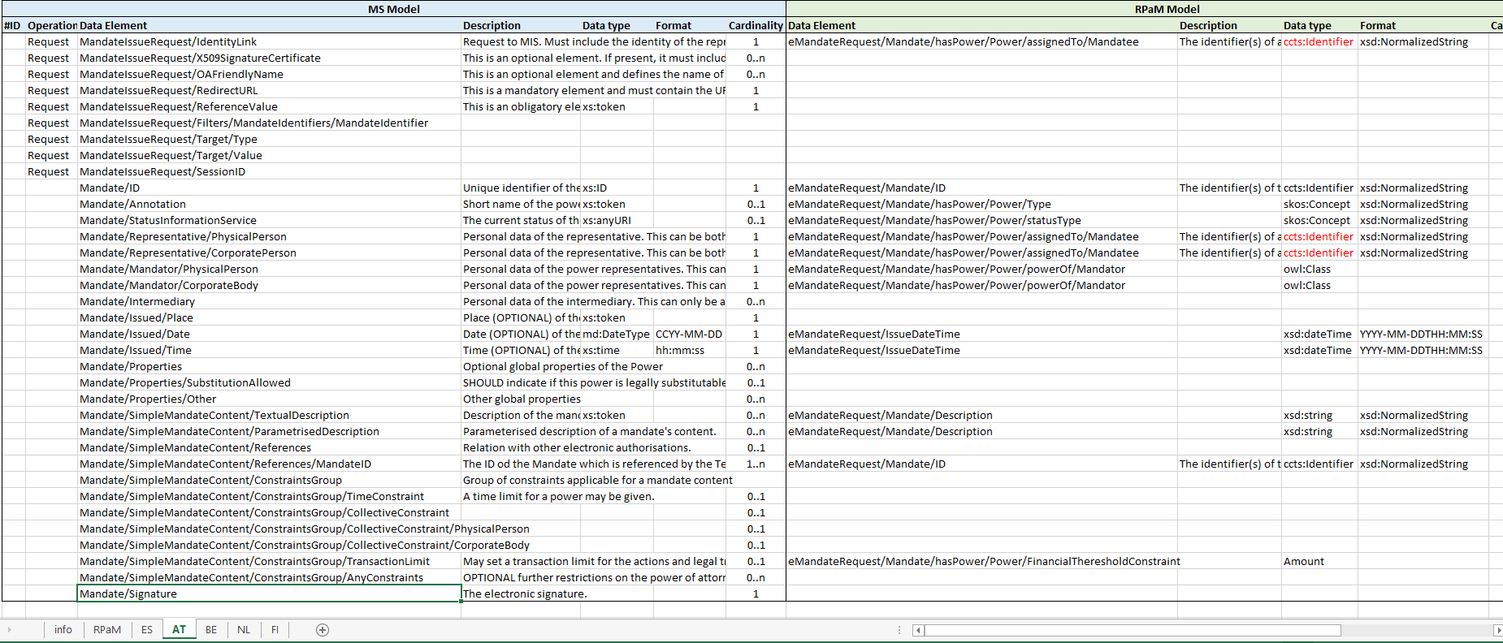
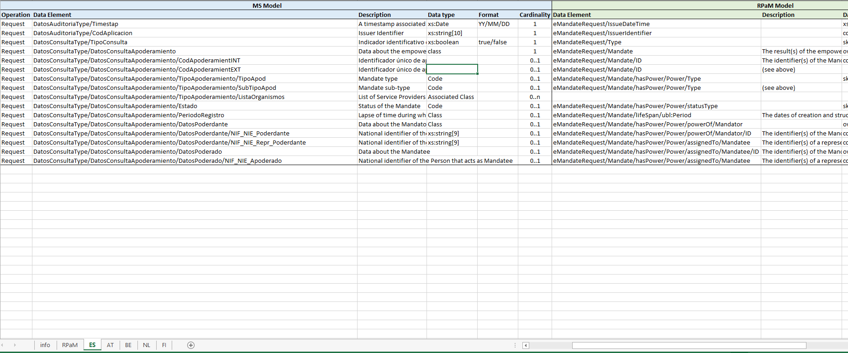
4
Ongoing activities: mapping IRs

Slide 12
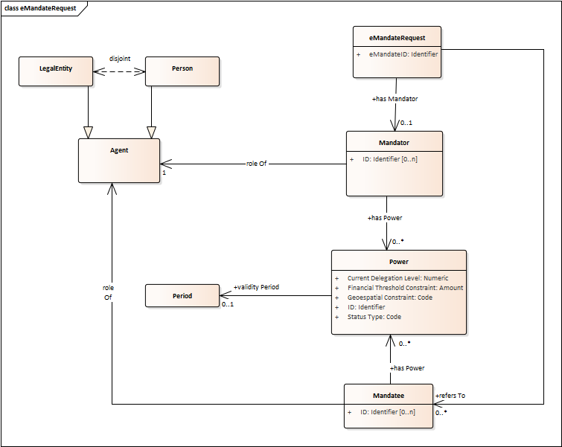
4
Ongoing activities: RPaM Ontology previous
V1.0.0

Slide 13
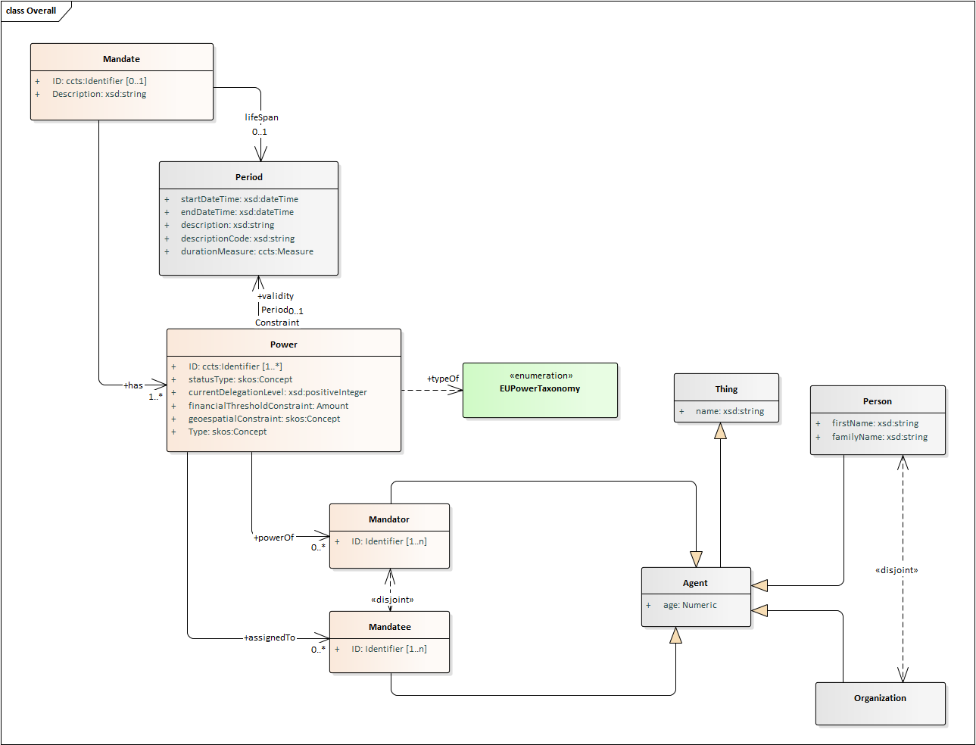
4
Ongoing activities: RPaM Ontology evolution
V1.1.0

Slide 14
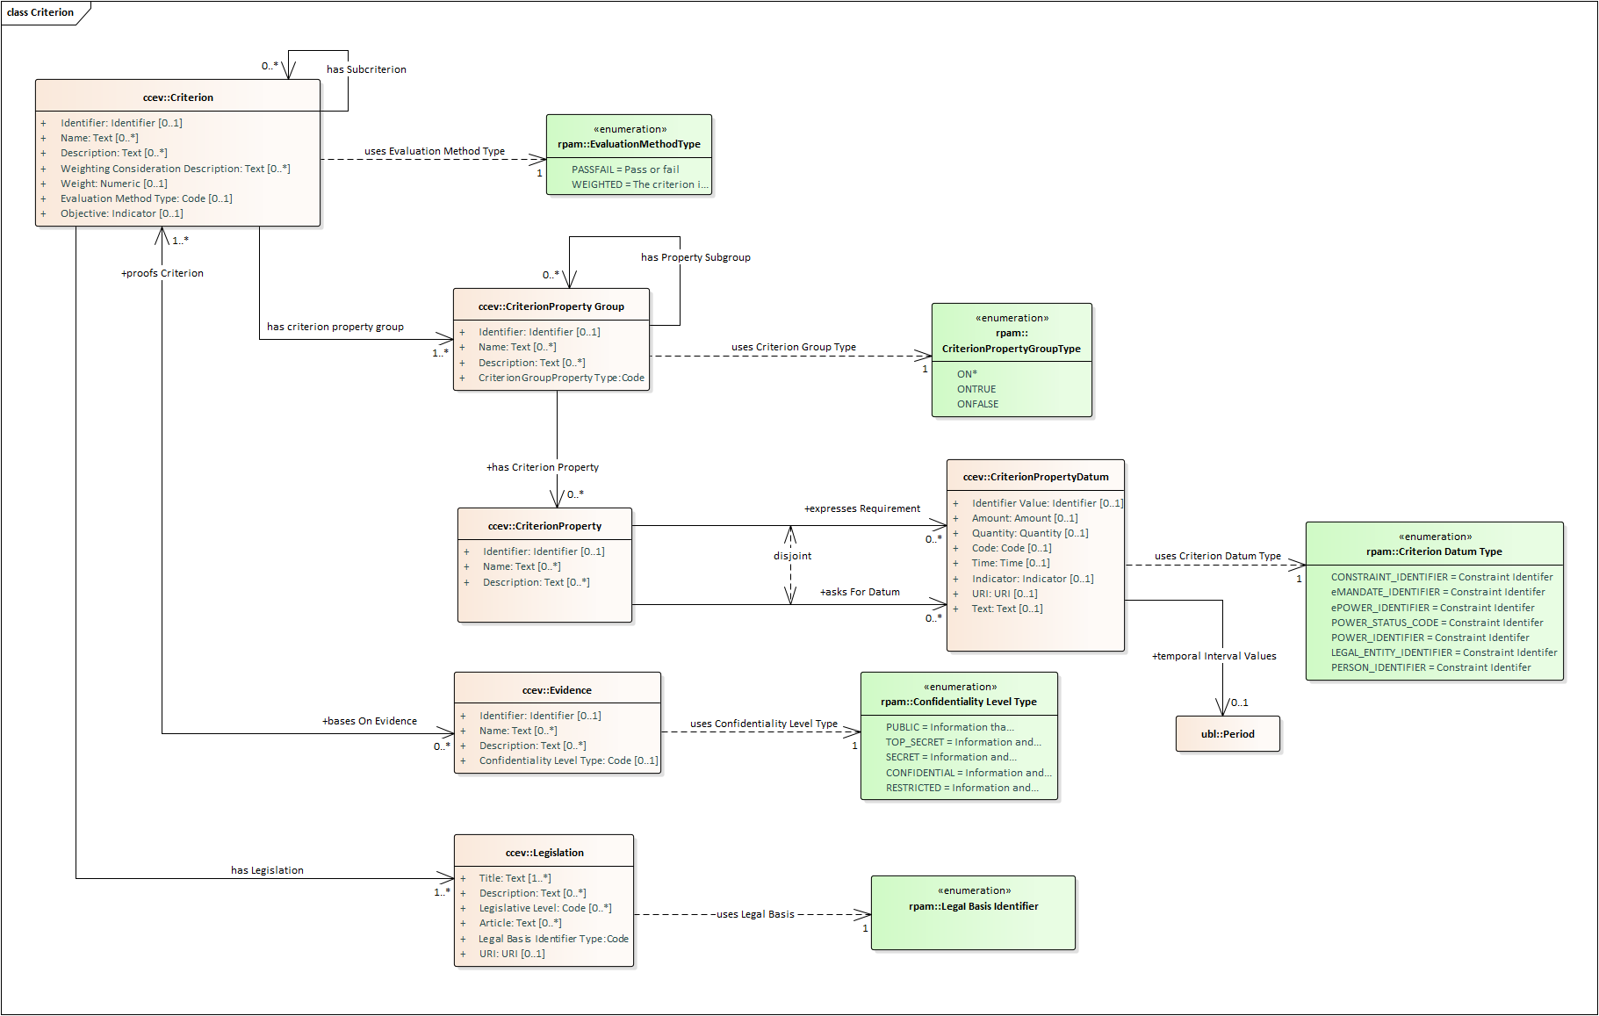
4
Ongoing activities: use of the CCEV in RPaM
Reminder

Slide 15
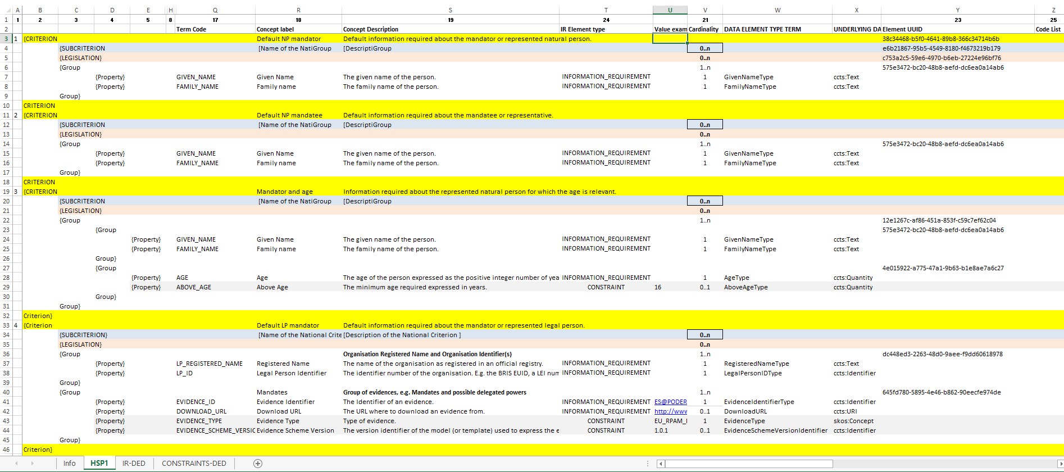
4
Ongoing activities: use of the CCEV in RPaM
SP (Service Provider) Information Requirements and Constraints in a “visual” mode

Slide 16
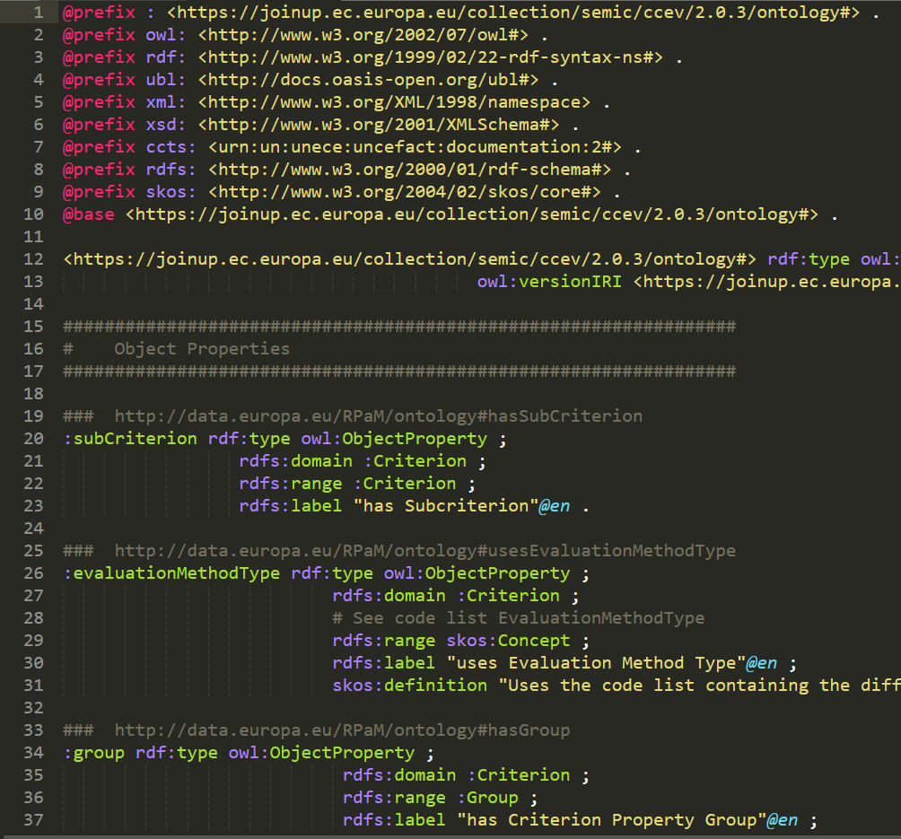
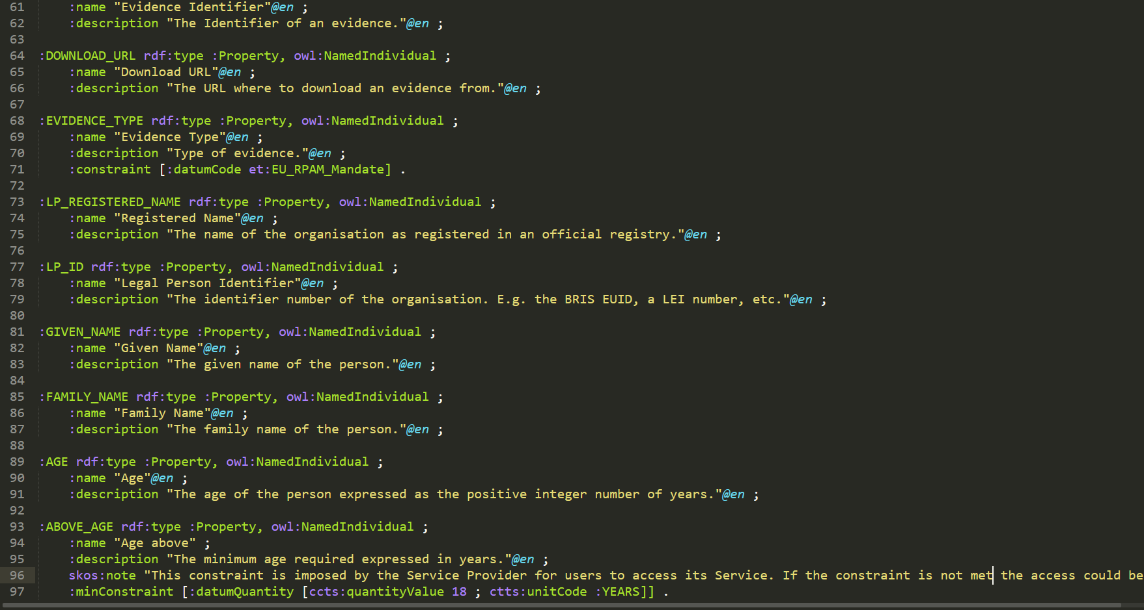
4
Ongoing activities: use of the CCEV in RPaM
Implementation of the SP Information Requirements and Constraints
https://github.com/everis-rpam/RPaM-Ontology/blob/v1.1.0/02-Vocabularies/CCEV/ccev.ttl
https://github.com/everis-rpam/RPaM-Ontology/blob/v1.1.0/04-SP-Information_Requirements/SP-Request.ttl

Slide 17
4
Ongoing activities: needs and rules
Need for Identifier Policy
Define/Adopt an Identifier(s) Policy for NP, LG and other entities (e.g. Agents)
Examples:
OpenPEPPOL policy for identifiers (https://peppol.eu/wp-content/uploads/2017/12/PEPPOL_Policy-for-use-of-identifiers-300-11_certificates.pdf)
EMSFEI (https://ec.europa.eu/cefdigital/wiki/display/SDBX/2018/11/23/CEF+eInvoicing%3A+Publication+of+the+Electronic+Address+Scheme+Code+List)
UN/CEFACT code list for Agency IDs (http://www.unece.org/trade/untdid/d08a/tred/tred3055.htm)

Slide 18
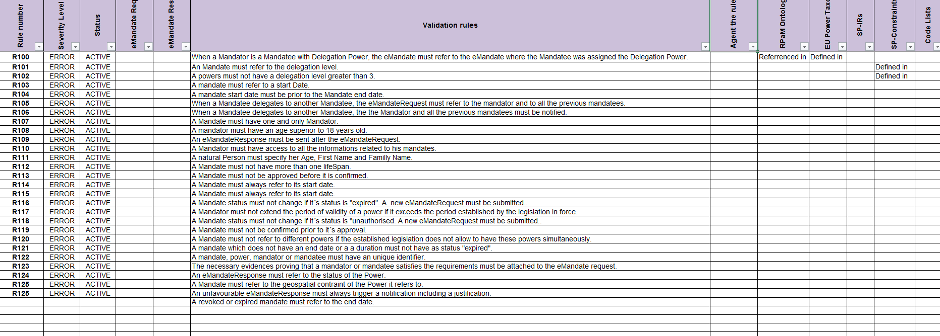
4
Ongoing activities: needs and rules
Business and technical rules

Slide 19
4
Ongoing activities: next tasks
Finish Request
Finish Response
Refine and enrich the business rules and policies
Business and technical rules

Slide 20
5
Requests
to the WG

Slide 21
5
Requests to the WG members
Please use the GitHub Issues to start new threads of discussion
Use the everis-rpam@everis.com email only for governance aspects (e.g. organising extra-ordinary WG meetings, other…)
Please provide Mandate, Request and Response Data Models (e.g. AT, ES are good examples)
Please provide us with Mandate, Request and Response instance samples (the more the better; we can provide help for data-masking)
Please provide examples of information requirements and constraints that SP impose to access their services.

Slide 22
Next
WG
sessions
6

Slide 23
6
Next WG meeting
21st. February 10 a.m. (in three weeks)

